Slide 1
Social Change
Rafael Marques

Slide 2
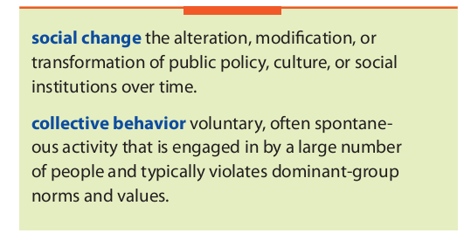

Slide 3
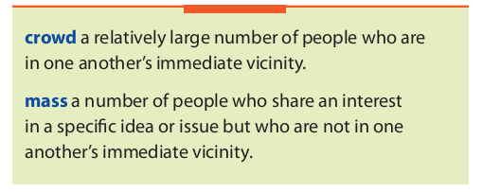

Slide 4
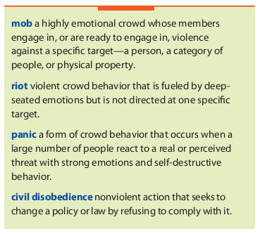

Slide 5
Emergent Norm Theory
Contagion Theory – Threshold Models
Social Unrest – Circular Reaction

Slide 6
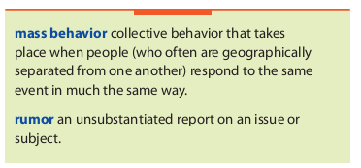

Slide 7
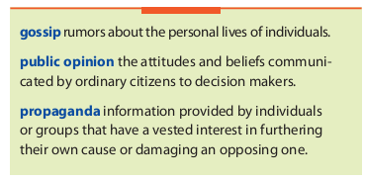

Slide 8
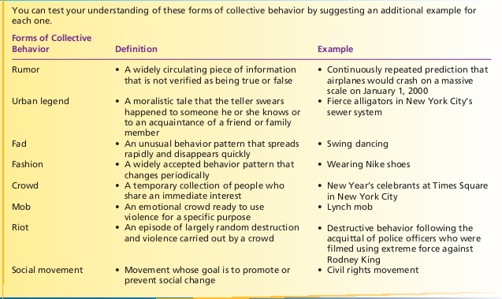

Slide 9
Mass Hysteria
Panic
Fads and Fashion

Slide 10
Social Change
Universality
Progress
Development/Growth
Direction
Control
Prediction
Trends

Slide 11
Post-Columbian Transfers of Native Organisms with Close Ties to Humans
Type of organism | Old World to New World | New World to Old World
Domesticated animals | cat (domestic - wild species already present) camel chicken cow donkey ferret goat (domestic - wild species already present) goose (domestic - wild species already present) honey bee horse rabbit (domestic) pig rock pigeon sheep (domestic) silkworm water buffalo guineafowl | alpaca American Mink (fur farming) guinea pig llama Muscovy Duck turkey

Slide 12
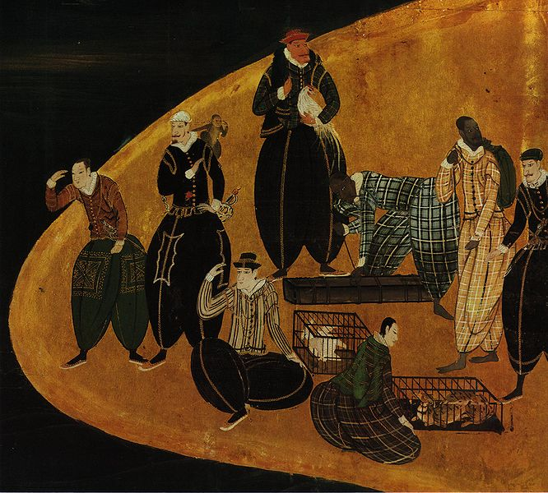

Slide 13
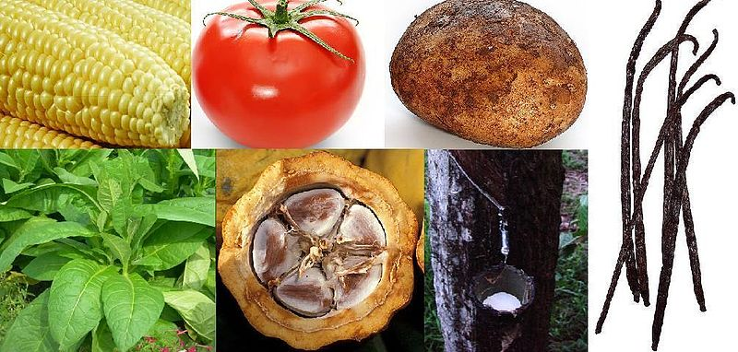

Slide 14
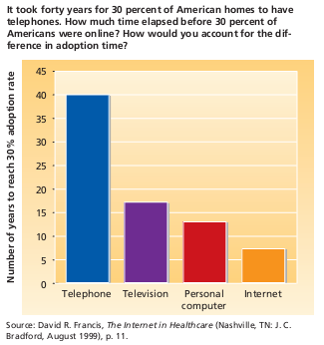

Slide 15
Social Change
Industrialization
Globalization
Rationalization
McDonaldization
Urbanization
Information
Education

Slide 16
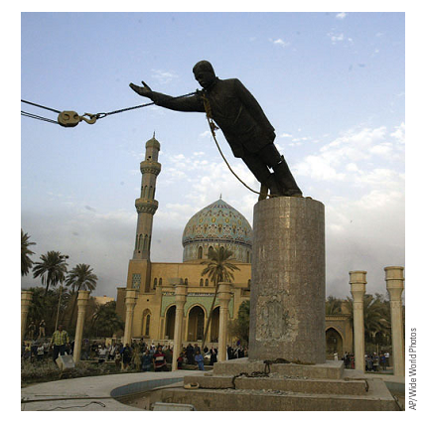
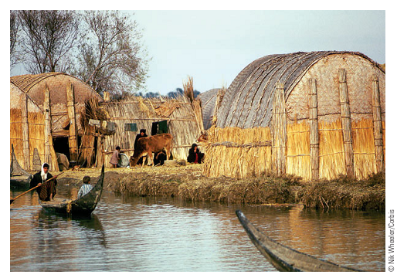
War and Modernization

Slide 17
War and Modernization
Ecological Impacts
Human Impacts
Cultural Transformation
War and Conquest
War and Epidemics
War and Violence
War and Social Institutions

Slide 18
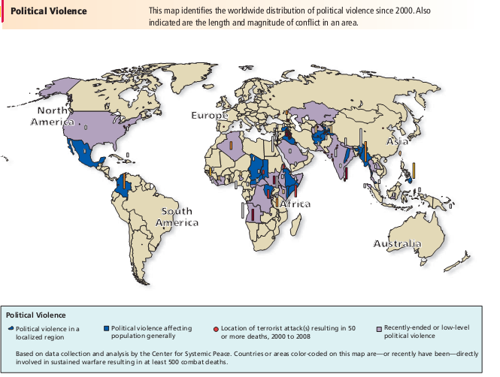

Slide 19
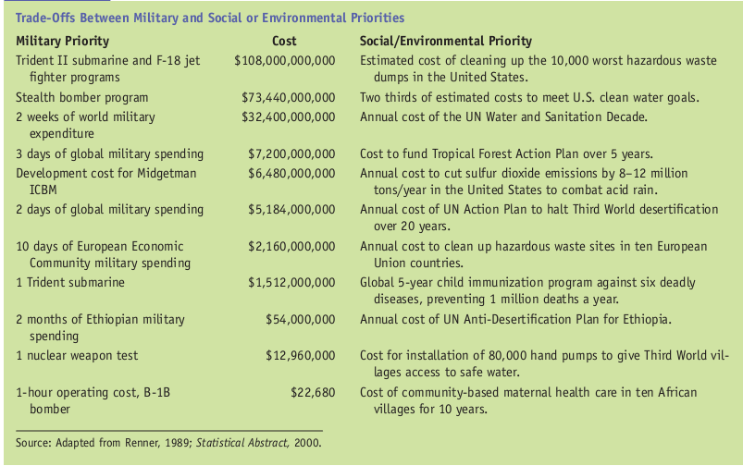

Slide 20
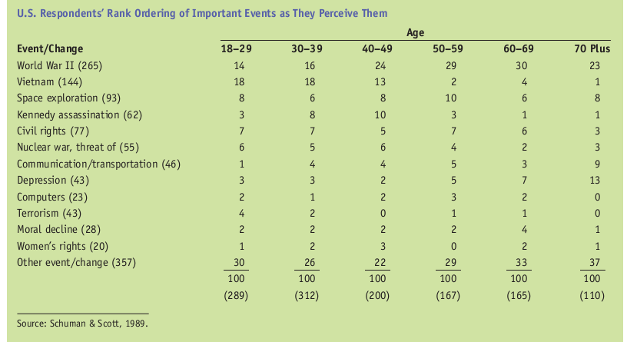

Slide 21
Modernization
Sectors
One Model/Many
Technologies
Unequal Modernization
Cultural Lag
Values
Laicism/Secularism
Rationality

Slide 22
Modernization
Reactions to Modernization
Stages of Modernity
Periphery and Core
Dependency
Gender and Family
Environment

Slide 23
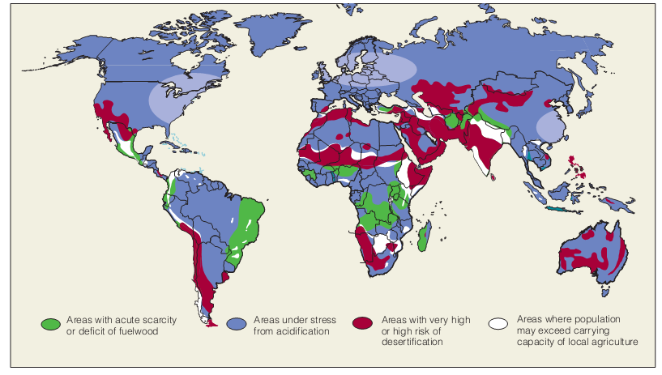
Modernization

Slide 24
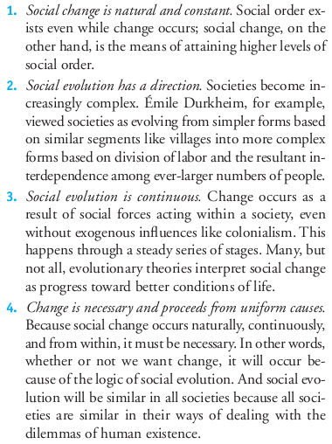
Evolutionary Models

Slide 25
Other Models
Cyclical – Decline and Rise
Conflict - Revolutions
Functionalist – Equilibrium
Models of Diffusion

Slide 27
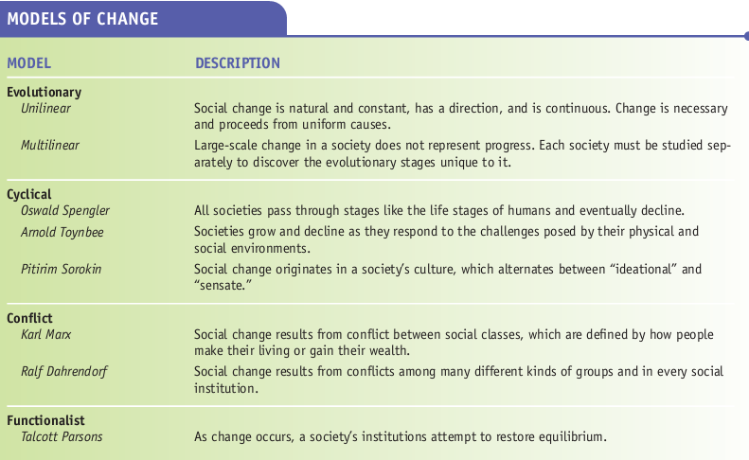

Slide 28
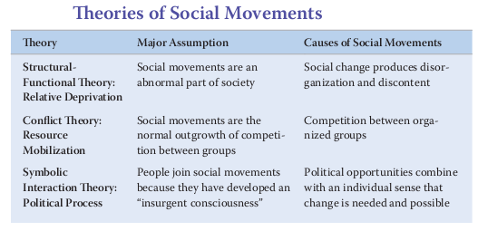
Social Movements

Slide 31
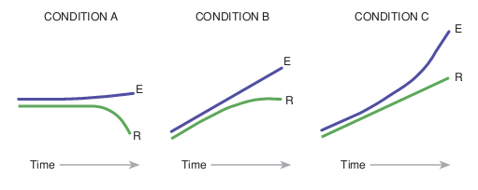
Relative Deprivation

Slide 32
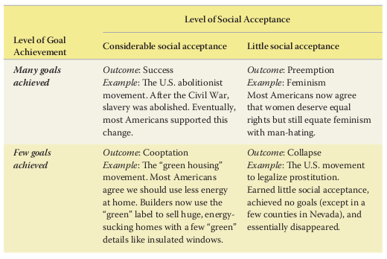
Social Movements

Slide 33
Social Movements

Slide 34
Cycle
Incipiency
Coalescence
Institutionalization
Fragmentation
Demise

Slide 35
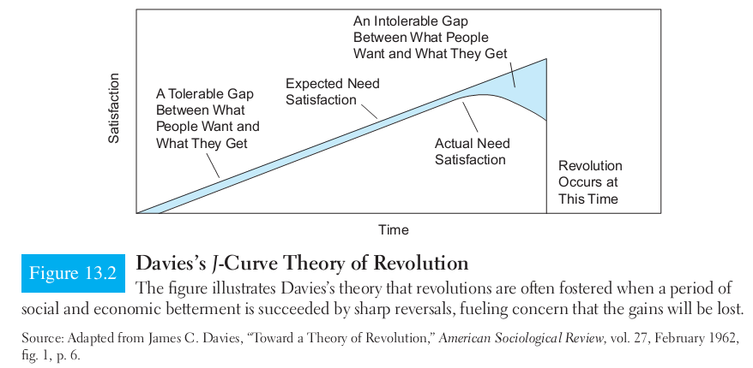

Slide 36
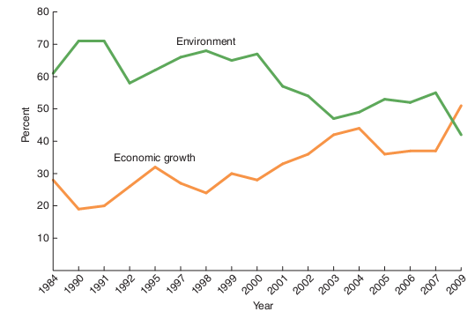

Slide 37
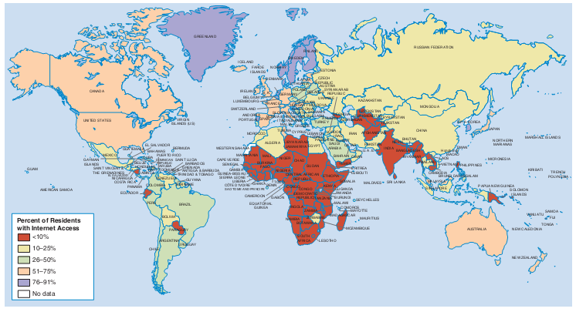

Slide 38
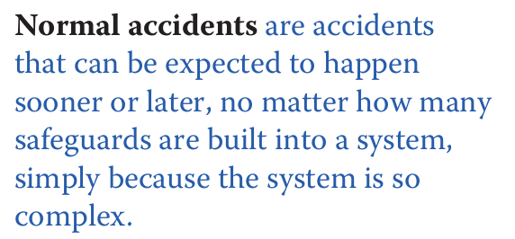

Slide 39
